Slide 1
SQL Capstone Project
Cohort ID : DS41B
Student ID : S8272 (Bhawana Gupta)

Slide 2
Purpose
To gain insight into the sales data of Amazon to understand the different factors that affect sales of the different branches.

Slide 3
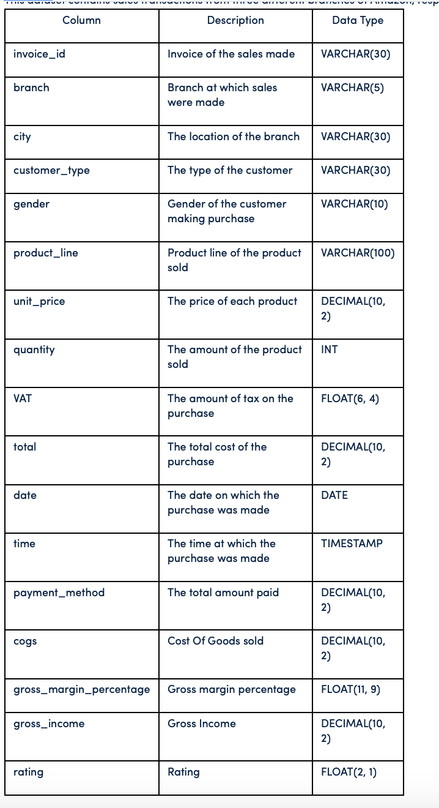
Dataset

Slide 4
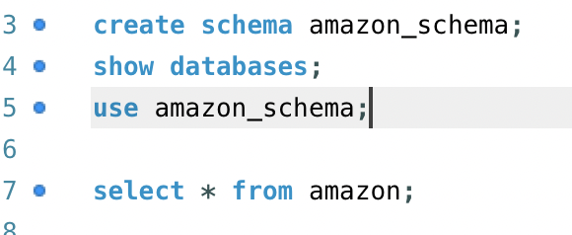
Data Wrangling
Build database and data population

Slide 5
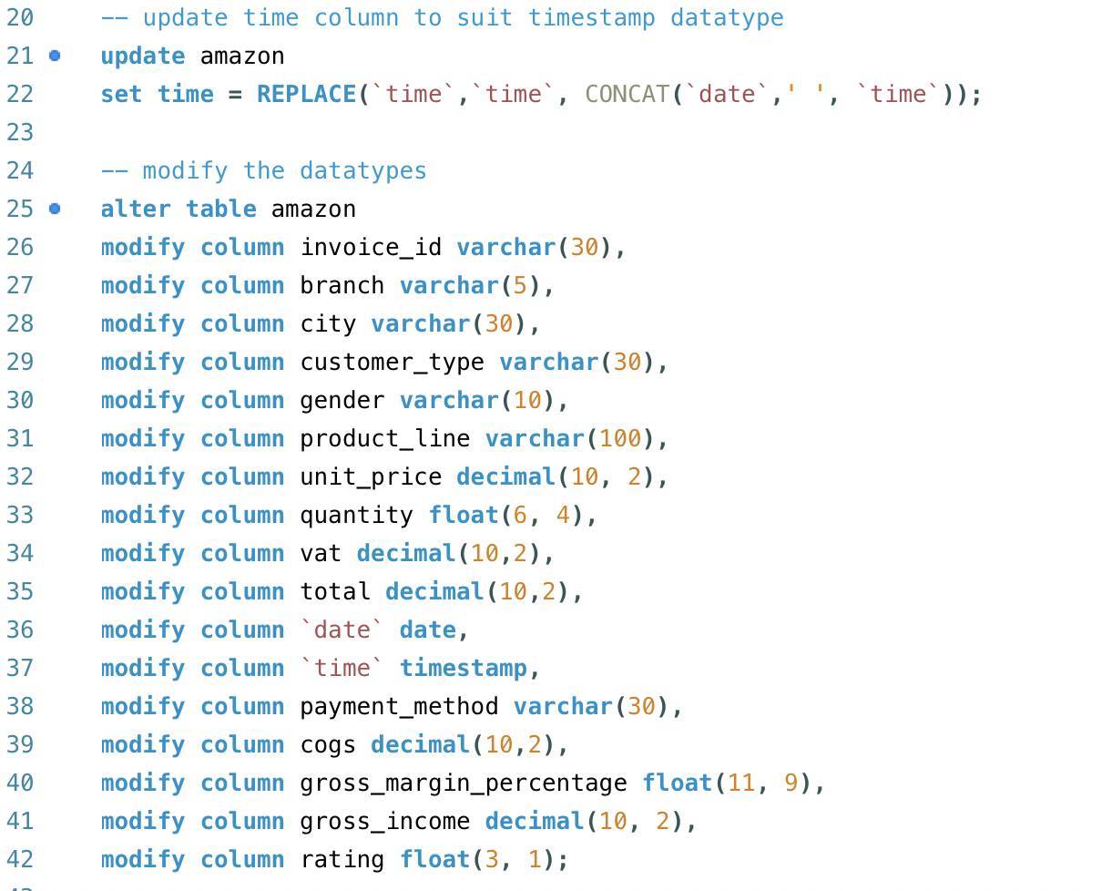
Data Wrangling

Slide 6
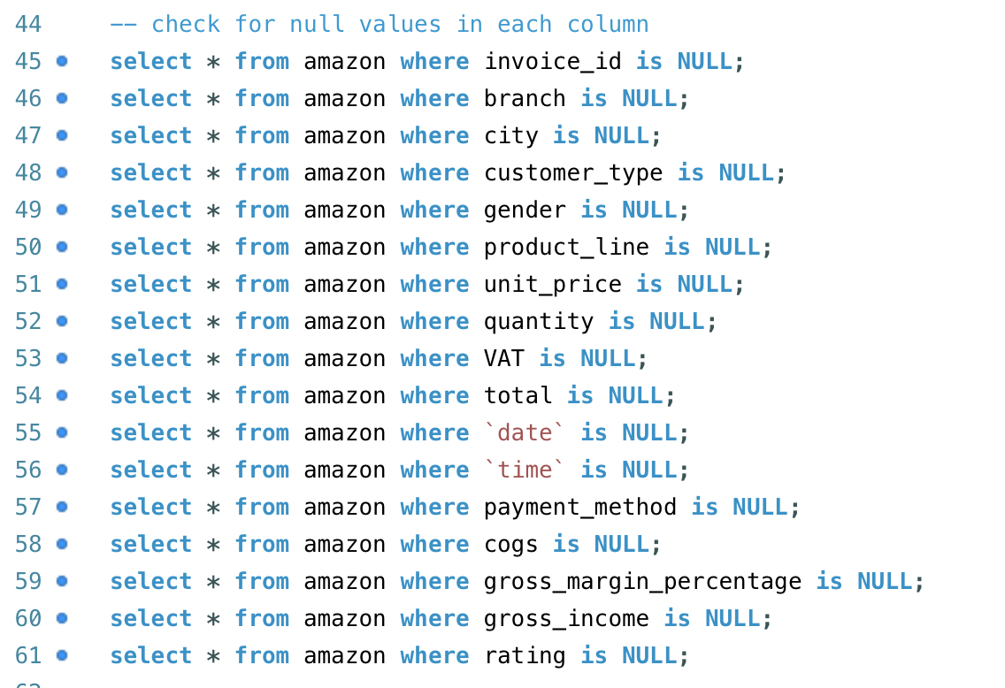
Data Wrangling

Slide 7
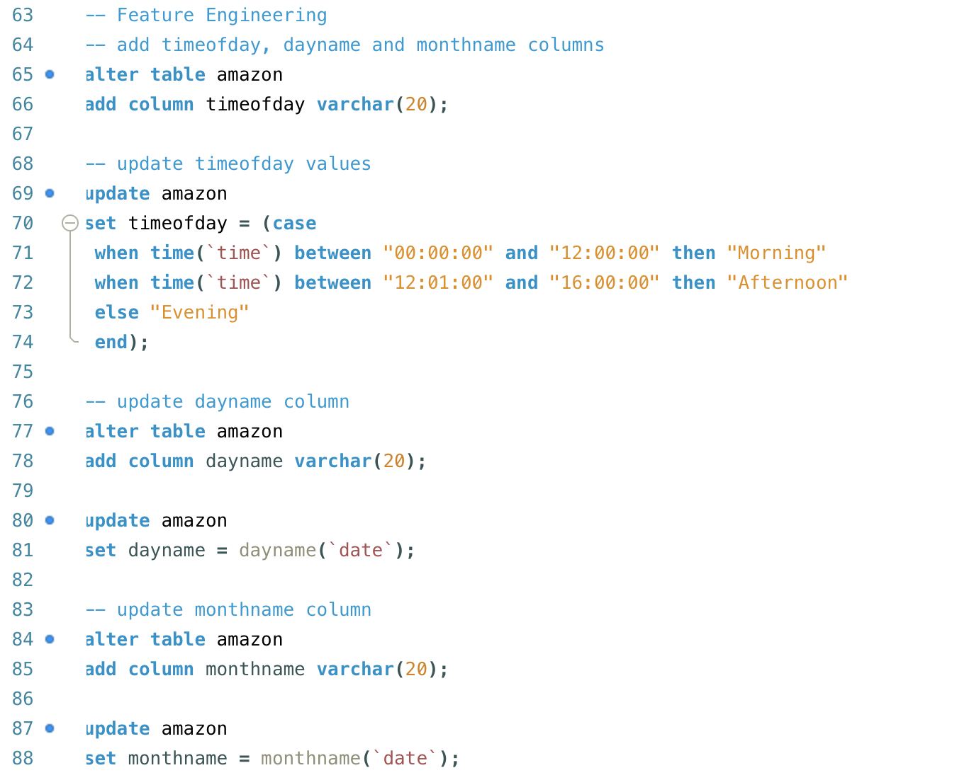
Feature Engineering

Slide 8
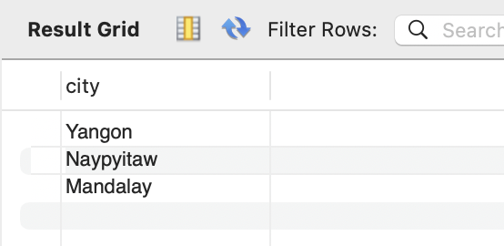
EDA
Q1 : What is the count of distinct cities in the dataset?
A1 : There are 3 cities (Yangon, Naypyitaw, Mandalay).

Slide 9
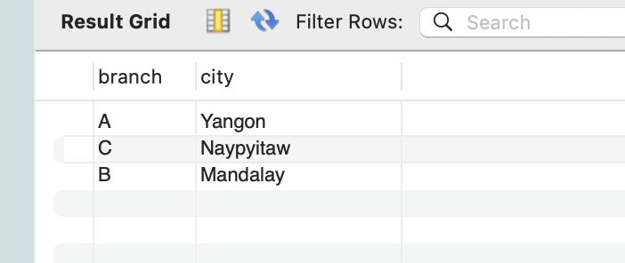
EDA
Q2 : For each branch, what is the corresponding city?
A2 : (Branch - city) A - Yangon, B - Mandalay, C – Naypyitaw

Slide 10
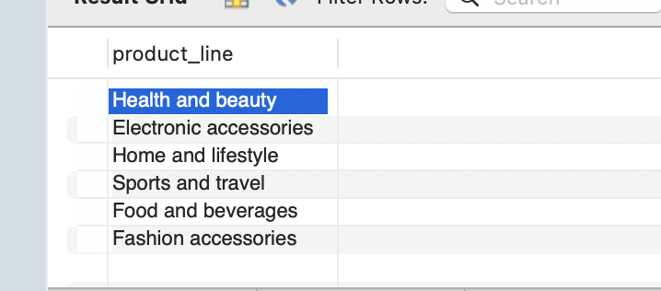
EDA
Q3 : What is the count of distinct product lines in the dataset?
A3 : 6 product_lines

Slide 11
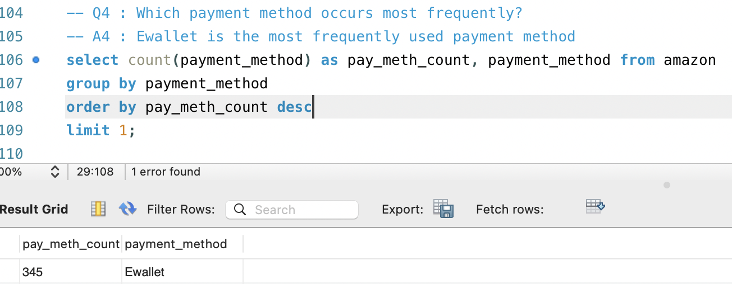
EDA
Q4 : Which payment method occurs most frequently?
A4: Ewallet is the most frequently used payment method

Slide 12
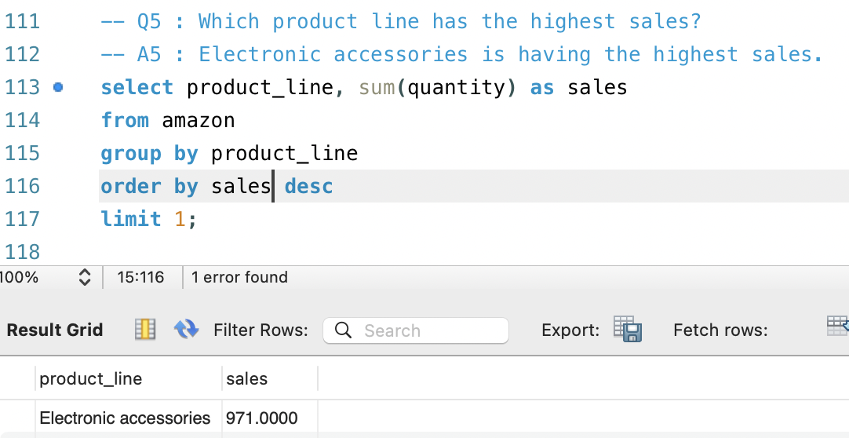
EDA
Q5: Which product line has the highest sales?
A5: Electronic accessories

Slide 13
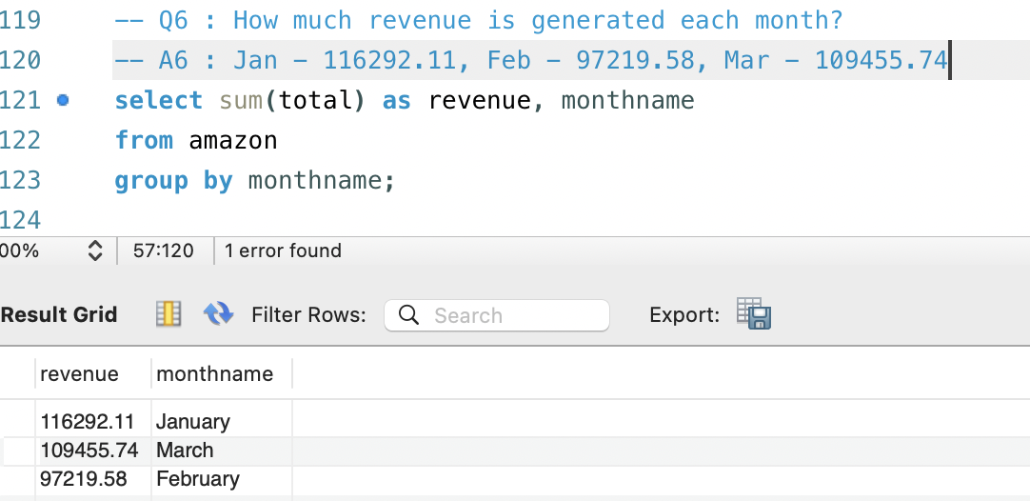
EDA
Q6: How much revenue is generated each month?
A6:

Slide 14
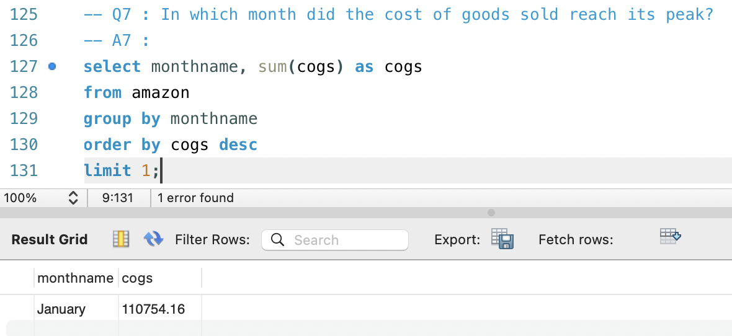
EDA
Q7: In which month did the cost of goods sold reach its peak?
A7: January

Slide 15
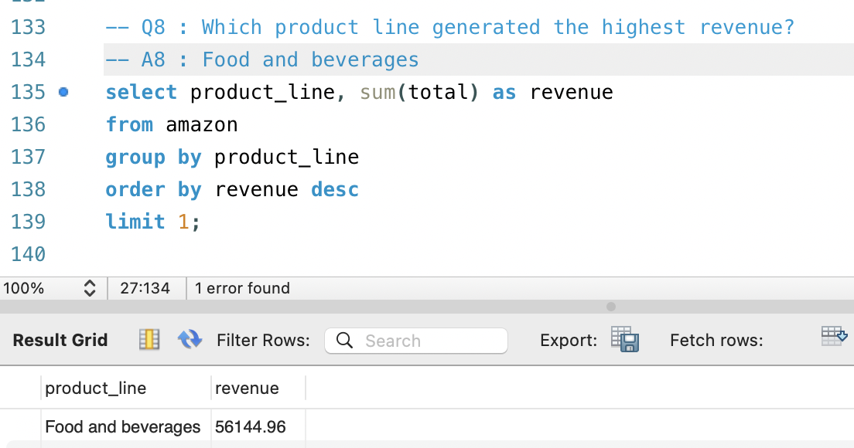
EDA
Q8: Which product line generated the highest revenue?
A8: Food and beverages

Slide 16
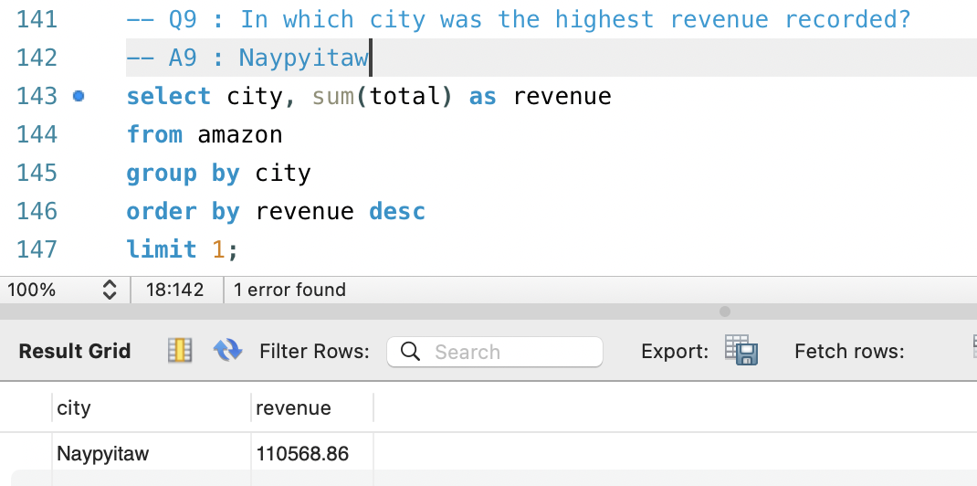
EDA

Slide 17
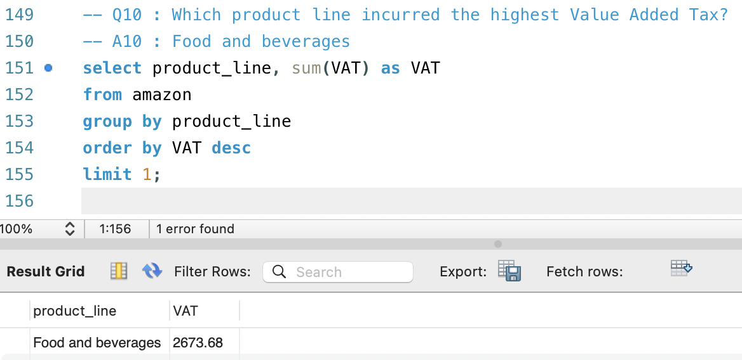
EDA

Slide 18
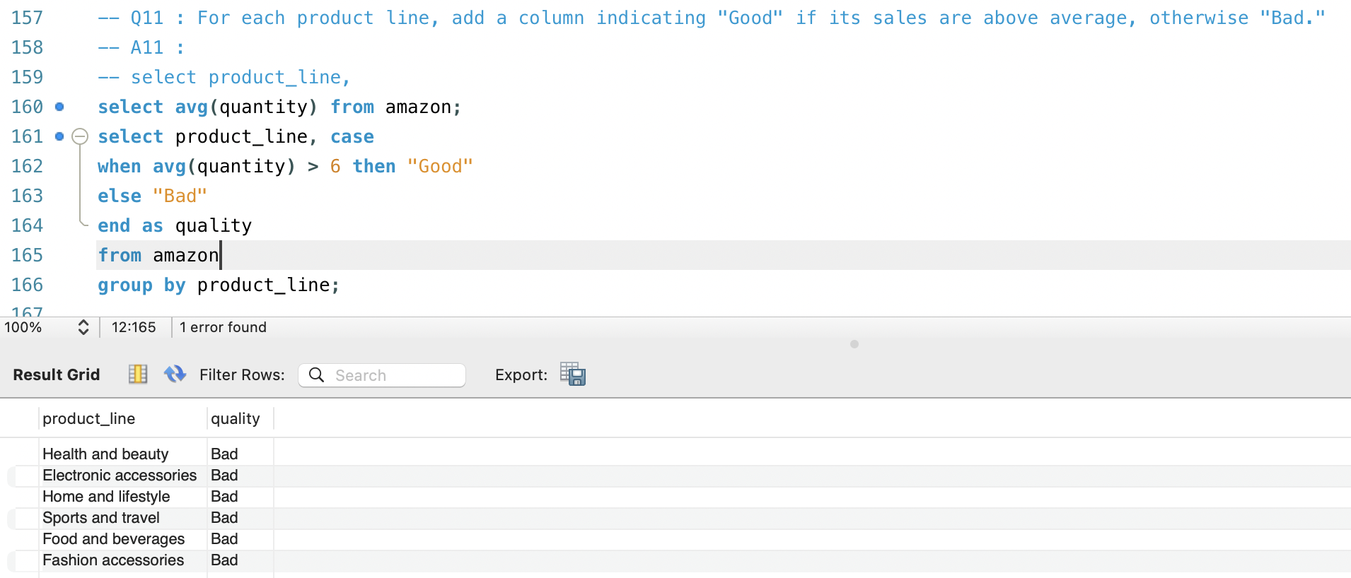
EDA

Slide 19
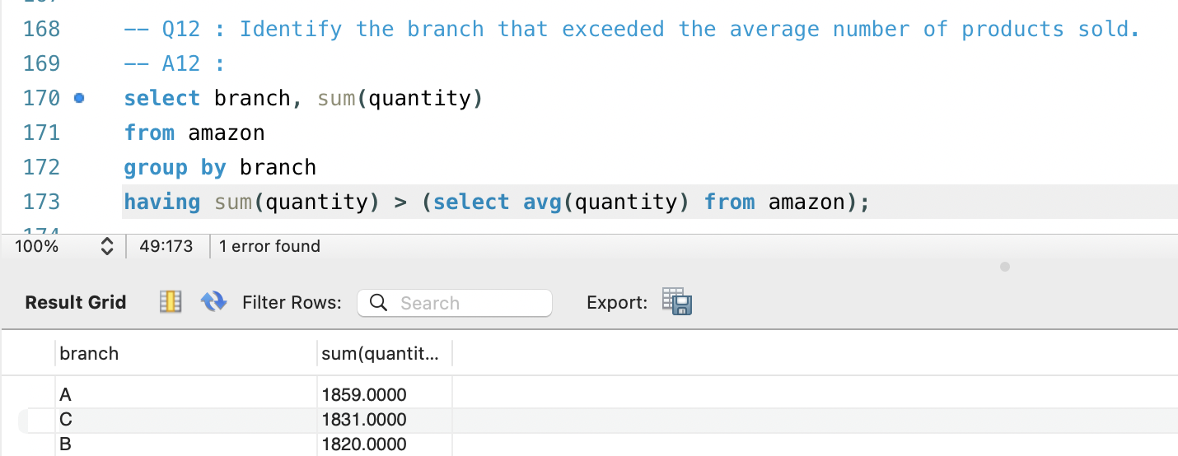
EDA

Slide 20
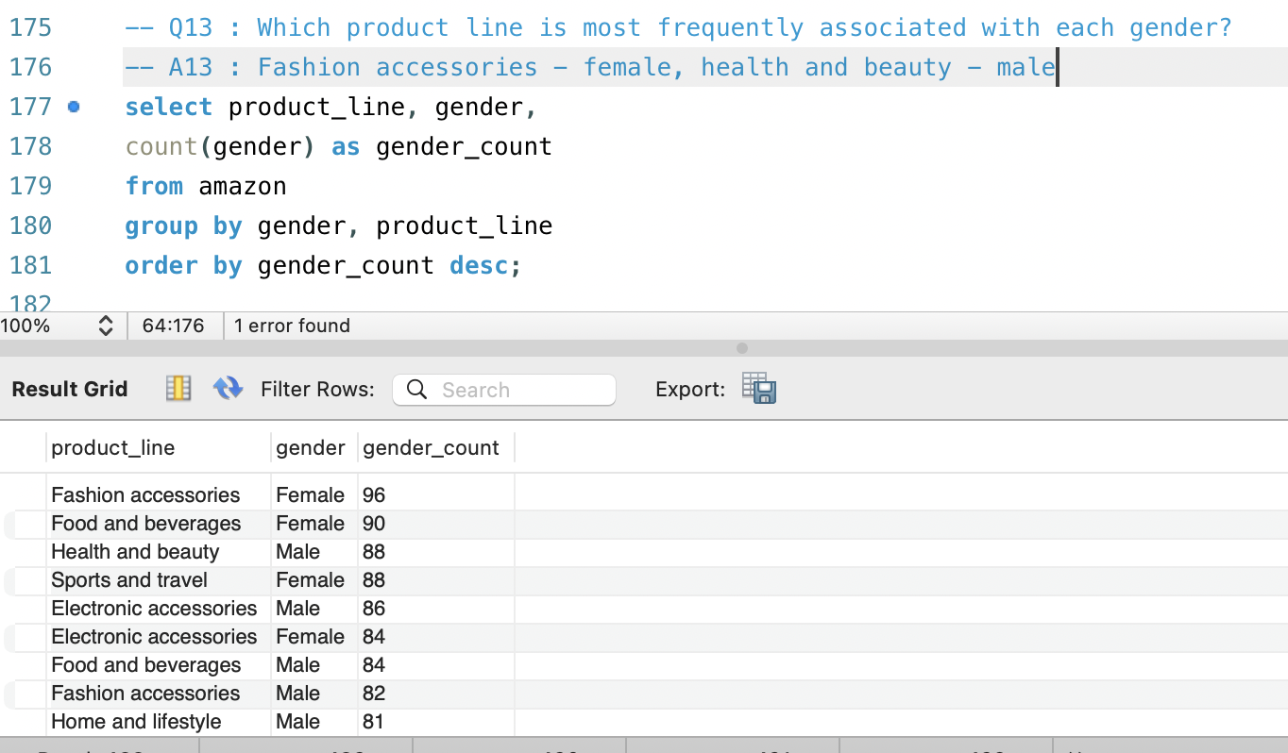
EDA

Slide 21
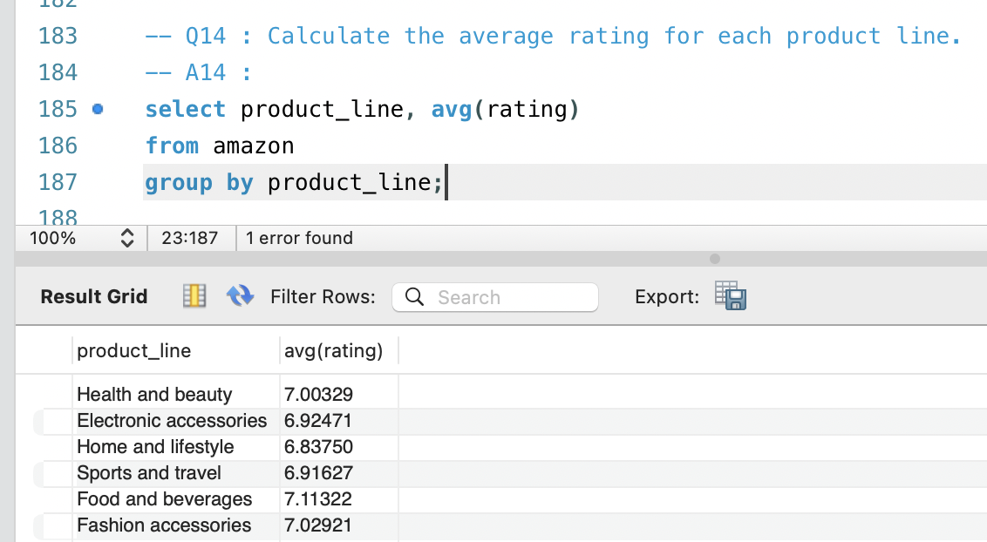
EDA

Slide 22
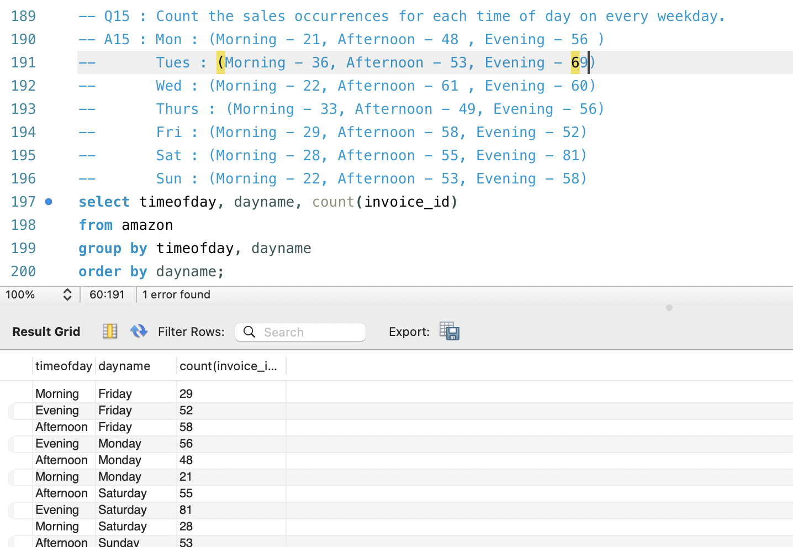
EDA

Slide 23
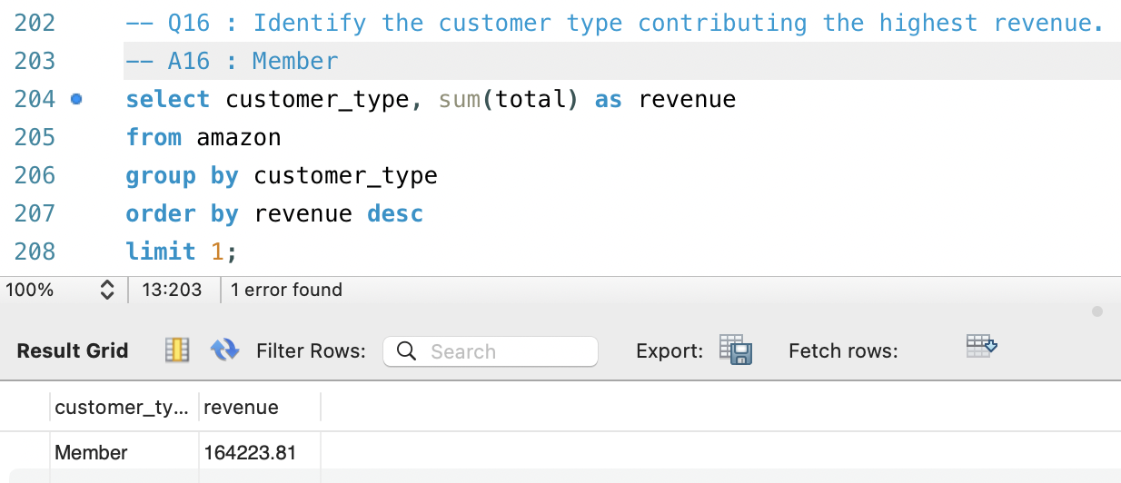
EDA

Slide 24
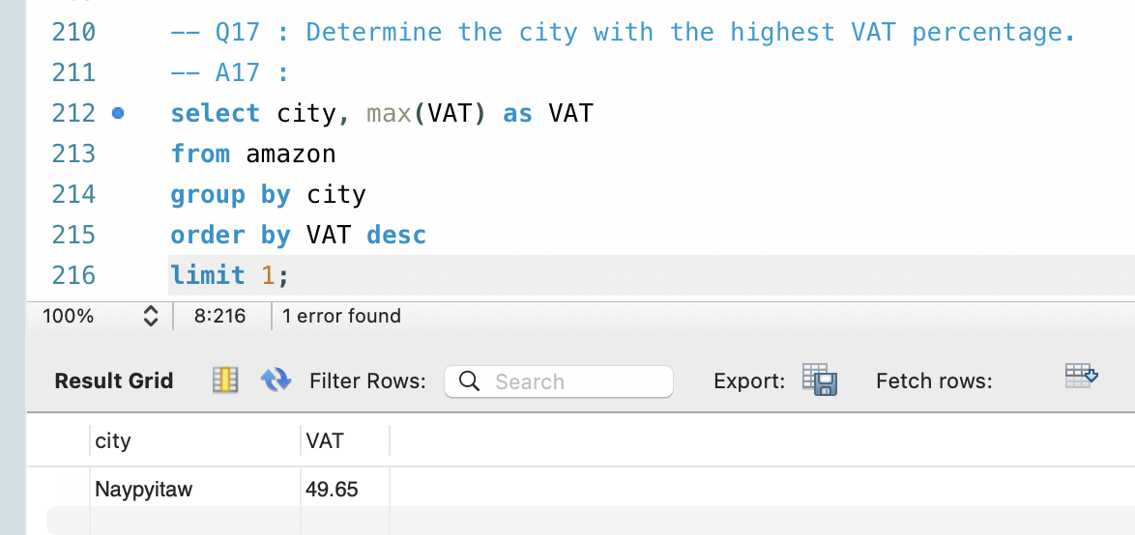
EDA

Slide 25
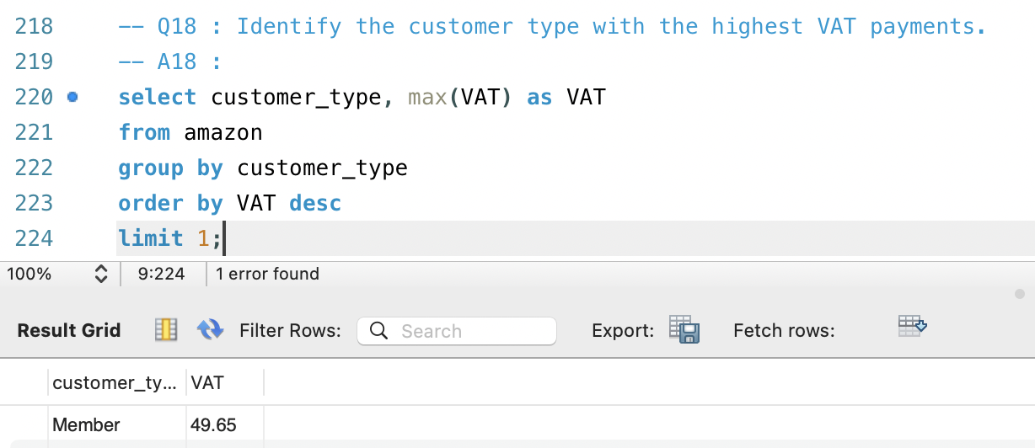
EDA

Slide 26
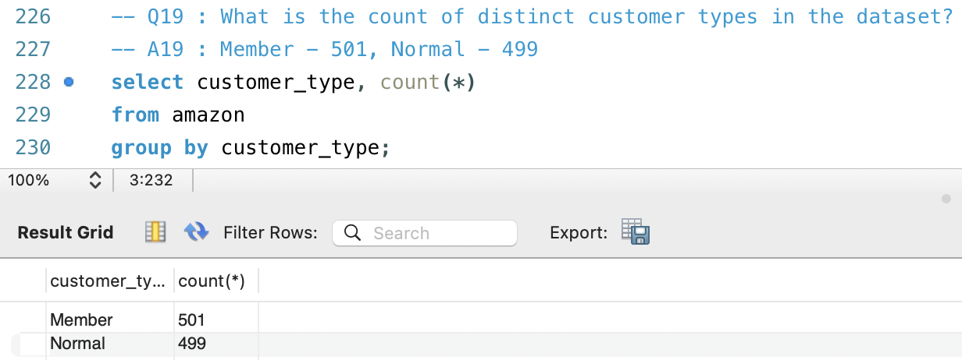
EDA

Slide 27
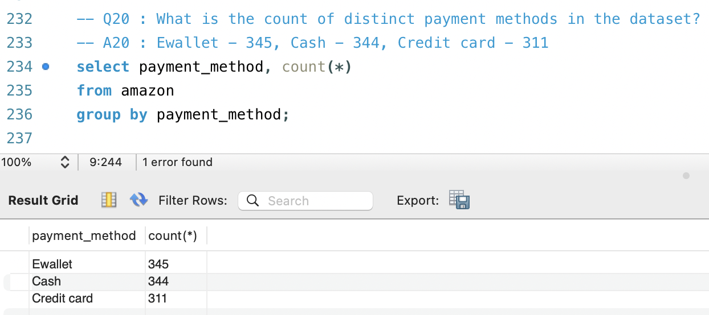
EDA

Slide 28
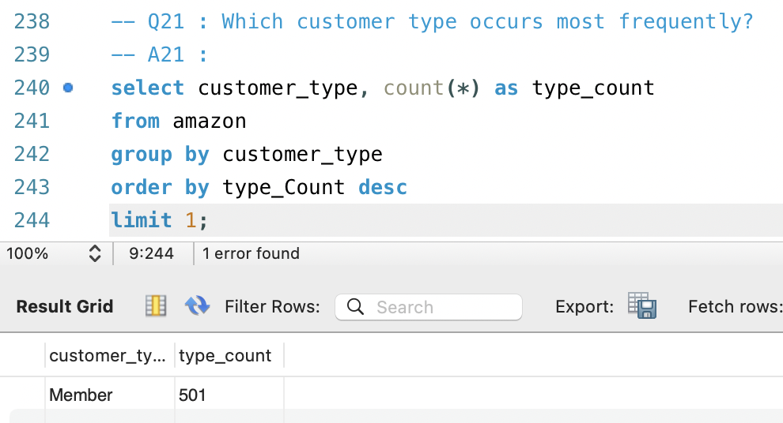
EDA

Slide 29
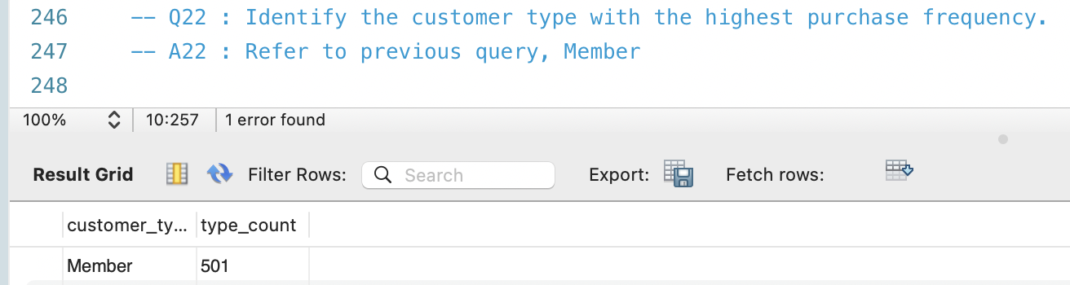
EDA

Slide 30
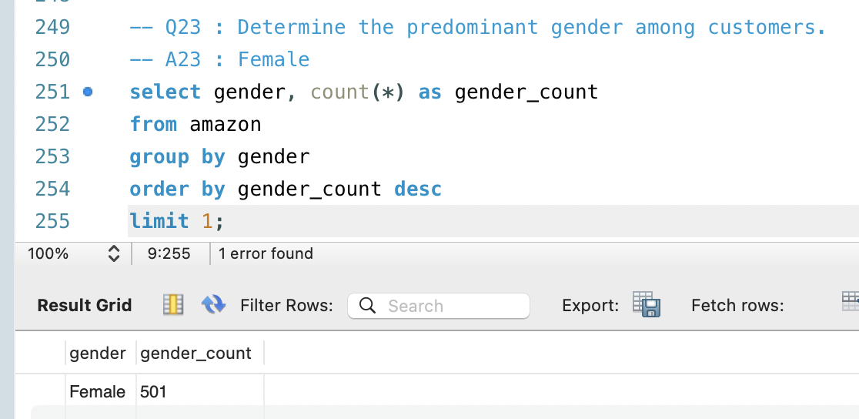
EDA

Slide 31
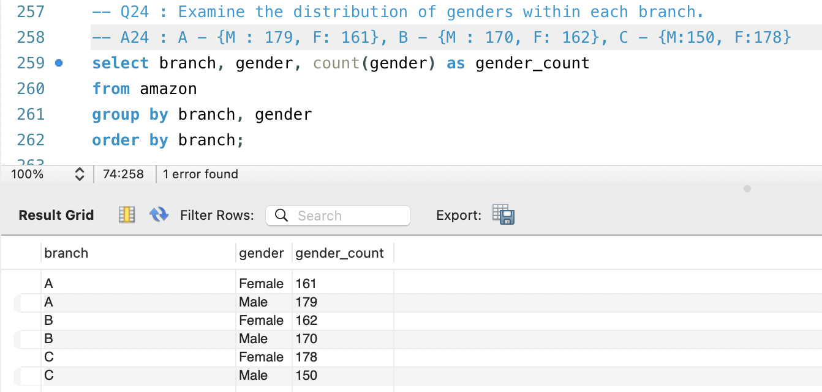
EDA

Slide 32
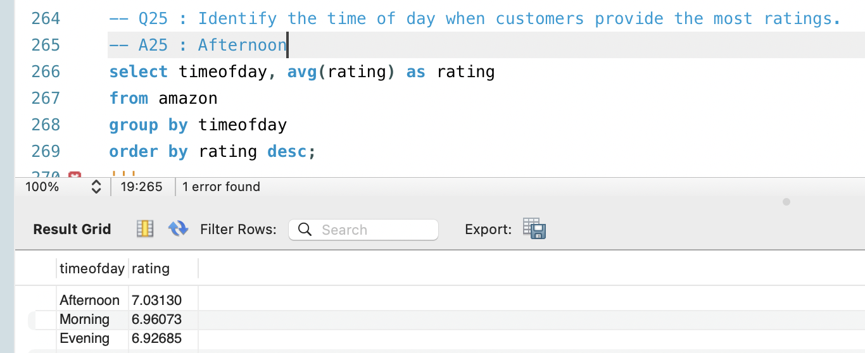
EDA

Slide 33
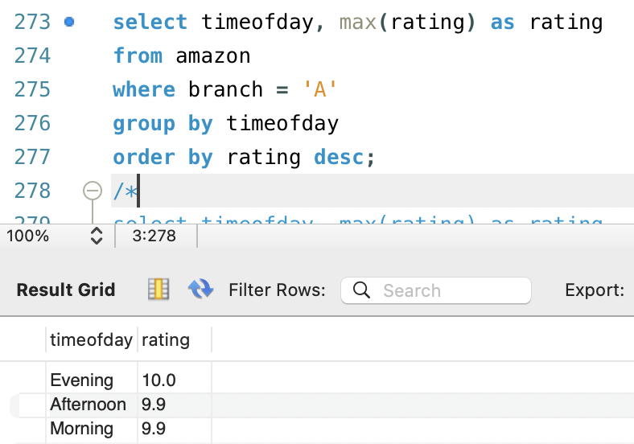
EDA
Q26: Determine the time of day with the highest customer ratings for each branch.

Slide 34
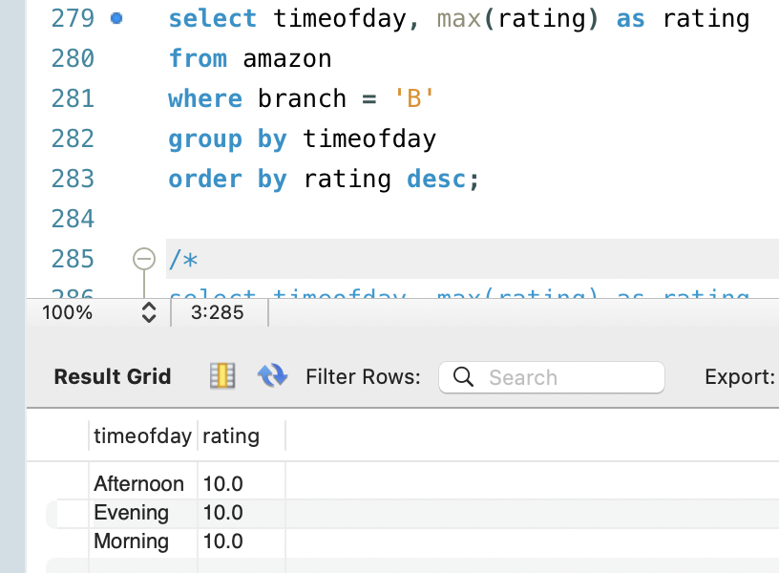
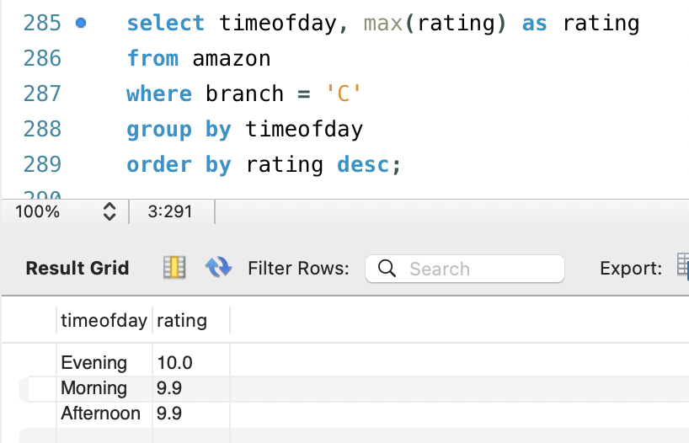
EDA

Slide 35
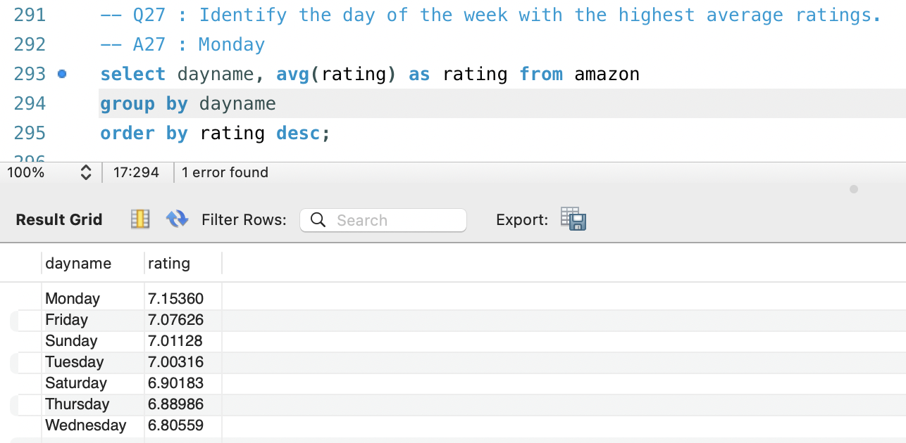
EDA

Slide 36
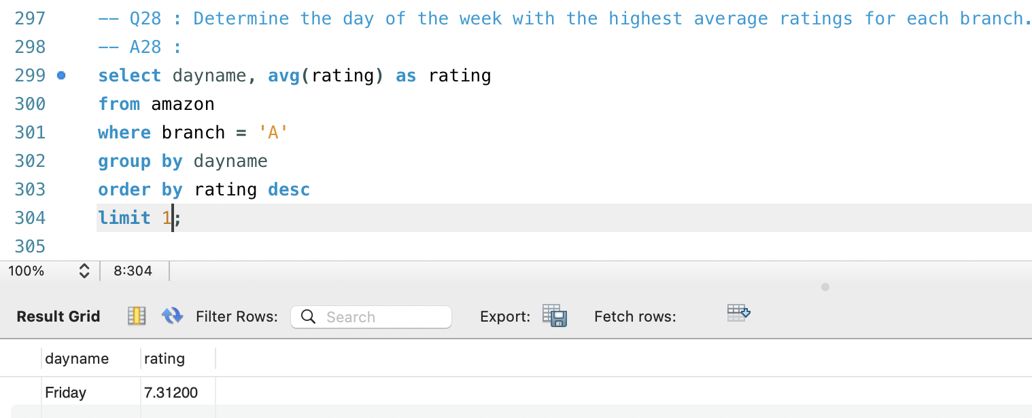
EDA

Slide 37
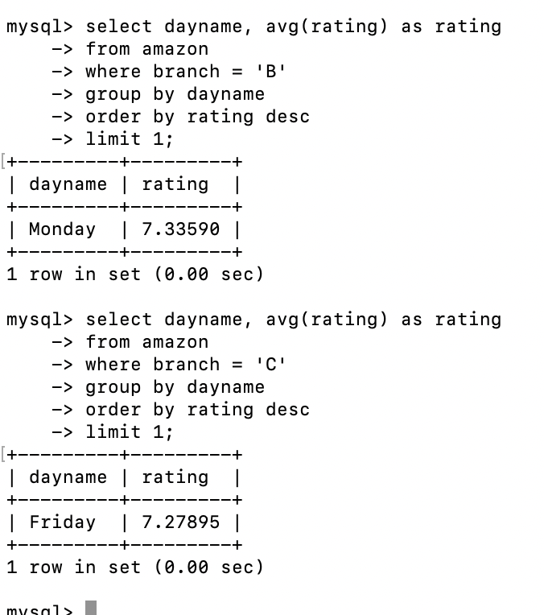
EDA

